Slide 1

MINI PROJECT
TEAM MEMBERS:
RIYA CHAURASIYA 123A9006
CHHAYA GAMI 123A9007
STUTI CHILWERI 123A9008
SAKSHI KALE 123A9016

Slide 2
HOUSE HUNTING

Slide 3
INTRODUTION
The house rental management system is a web-based application that helps property owners and tenants manage their rental properties.
The system allows property owners to list their properties, manage tenant applications, and collect rent payments.
Tenants can use the system to search for properties, apply for rentals, and pay rent.
The customer can easily search and find suitable place based on their budget, accommodation of people in that place.

Slide 4
PROBLEM STATEMENT
Students and bachelors frequently struggle with finding housing that is both affordable and meets their specific needs. The various unique requirements, such as : Affordability, Location: Proximity to campuses, universities, or workplaces is crucial, Lease Terms: Flexible or short-term lease options are often needed, Roommates, Verification and Safety.

Slide 5
OBJECTIVE
To create a secure software that will be beneficial for both the students/ youngsters looking out for pgs or rentals and to the person who is interested in making their place available for renting.

Slide 6
Software Requirements
Language used: PYTHON
LIBRARIES:
PANDA
Analysis and clean collected data.
NUMPY
For numerical operations.
This is the standard Python interface to the Tk GUI toolkit. It provides a variety of widgets for building a graphical user interface.
TKINTER

Slide 7
Review of Literature
Year | Paper Name & Author | Problem Addressed | Gap
IEEE, 2022 | Chongdarakul, Waralak and PunnarumolTemdee Real Estate Management System of Personal Seekers for Investment Decision
IEEE, 2016 | Li, Wei, and J. F. Xiong Design and implementation of the management system of house lease
2020 | Ikuomola, A. J., and M. P. Asefon Secured Mobile Cloud-Based House Rental Management System

Slide 8
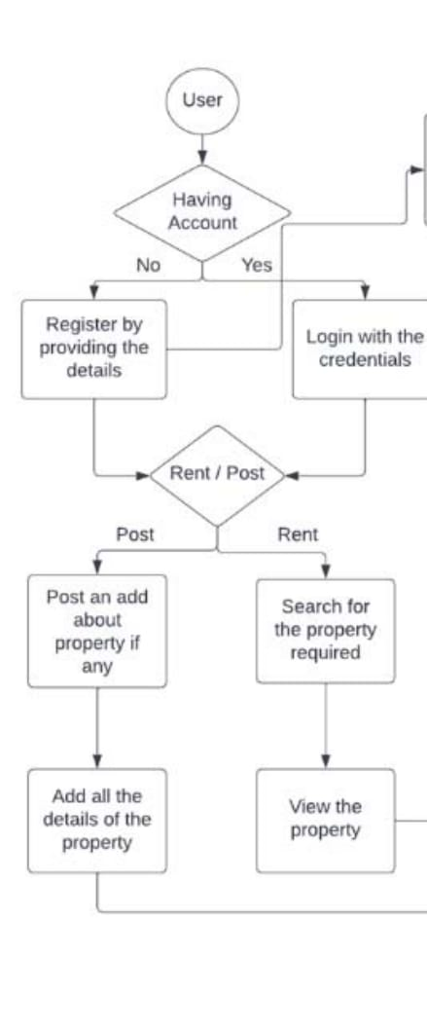
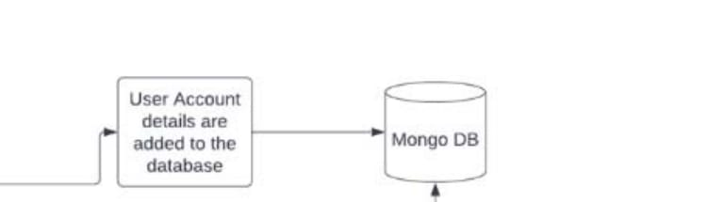
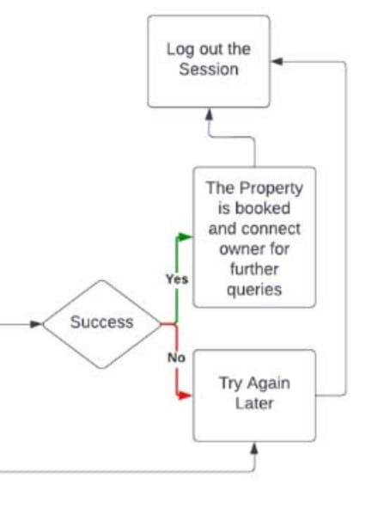
FLOWCHART

Slide 9
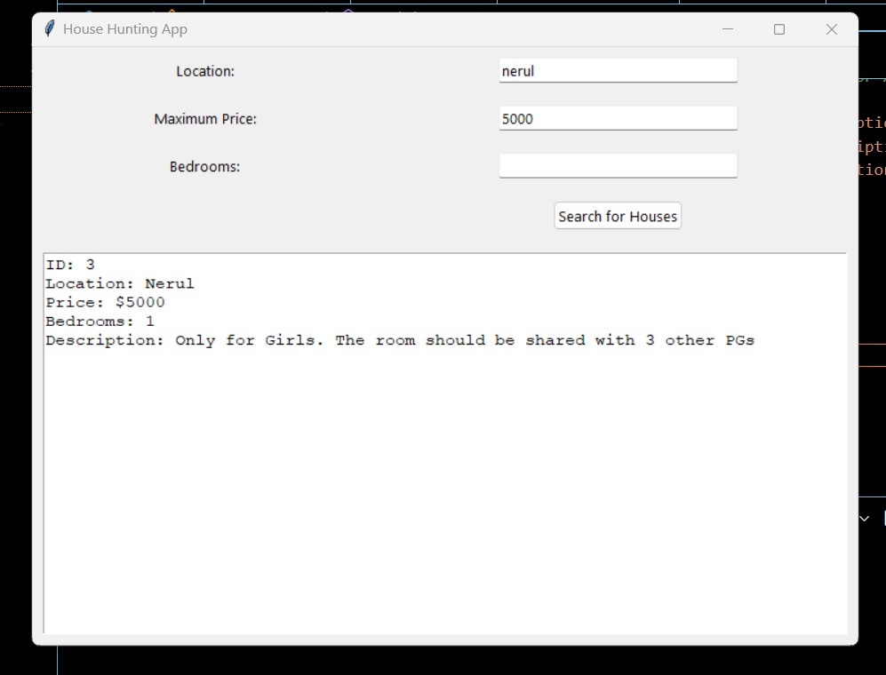
RESULT

Slide 10

FUTURE SCOPE
AI-Powered Recommendations:
Utilize AI to suggest properties to users based on their browsing history, preferences, and past interactions on the website.
Local Services Integration:
Partner with local service providers (e.g., movers, cleaning services, repair services) to offer users a comprehensive solution for all their rental needs.
Flexible Payment Options:
Introduce multiple payment methods and flexible rental payment plans, handle rental agreements directly through the website.
Enhanced Search Filters:
Once the pg or apartment is confirmed by any tenant then the availability of the pg will be dismissed automatically

Slide 11
CONCLUSION
In conclusion, the development of the house rental management system has provided a comprehensive and efficient solution for property owners and tenants. The project successfully addressed the challenges faced in the industry, such as lengthy wait times and manual processes, by streamlining the booking and management of rental properties. Through the implementation of a user-friendly interface, reliable database, and effective algorithms, the system has improved the overall rental experience

Slide 12
REFERENCE
https://www.ijirset.com/upload/2023/may/272_House_NC.pdf
https://www.riverpublishers.com/pdf/ebook/chapter/RP_9788770040723C53.pdf
https://ijarsct.co.in/Paper14357.pdf
https://www.ijirset.com/upload/2023/may/272_House_NC.pdf

Slide 13
THANK YOU

